Slide 1

Building a Web App for Decision Tree model
LIVE SESSION

Slide 2
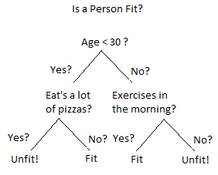
DECISION TREE
A decision tree is a supervised Machine learning algorithm
It is used for both classification and regression problems.
It is mostly used for classification tasks.
The goal is to build a model to predict the value of the target label by using simple decision rules inferred from data.

Slide 3
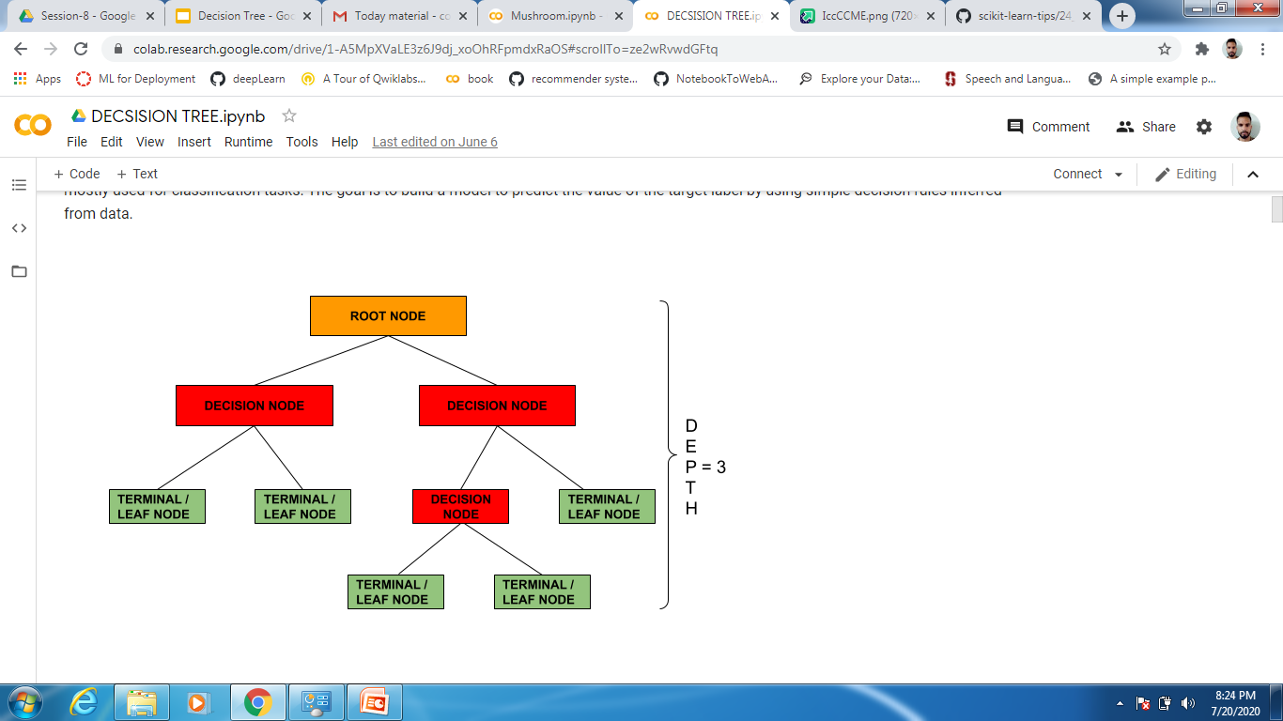
UNDERSTANDING THE BASIC TERMINOLOGIES OF DECISION TREE
A root node is the one where population data is present before any split.

Slide 4
UNDERSTANDING THE BASIC TERMINOLOGIES OF DECISION TREE
When a sub-node get divided further into sub nodes it is known as decision node.

Slide 5
UNDERSTANDING THE BASIC TERMINOLOGIES OF DECISION TREE
A node which does not get divided further into sub nodes is known as leaf/terminal node

Slide 6
UNDERSTANDING THE BASIC TERMINOLOGIES OF DECISION TREE
Depth is the longest path from root node to the leaf node.

Slide 7
UNDERSTANDING THE BASIC TERMINOLOGIES OF DECISION TREE
Splitting -
Process of dividing a node further into sub nodes.

Slide 8
UNDERSTANDING THE BASIC TERMINOLOGIES OF DECISION TREE
Pruning-
It is opposite of splitting. When a tree is fully grown we remove the sub nodes

Slide 9
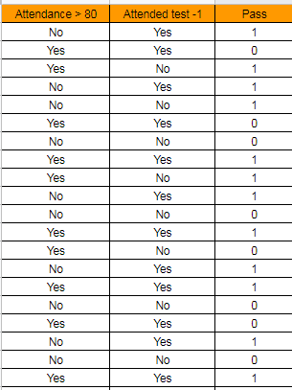
Deciding the best split in Decision Tree
Total Students | 20
Pass | 12
Fail | 8
Build a decision tree to classify them into different sub groups (Pass or fail)

Slide 10
How to decide on which variable to split first ?
Attended Test-1
Attendance > 80
Yes
No
Yes
No
Pass
Attendance > 80
Pass
Attended Test-1
Yes
No
Yes
No
Pass
Fail
Pass
Fail
Split on Attended test
Split on Attendance > 80

Slide 11
A decision tree uses multiple algorithms to decide to split a node into different sub nodes.
GINI
ENTROPY
A decision tree split the nodes on all the available variables and selects the one which results in more homogenous nodes.
The goal of any learning algorithm in decision tree is to find the best split.

Slide 12
Pure Node
If we select two items from a population at random they must be of same class and probability for this is 1 if sample is pure
Impure Node
If we select any two points at random they will be of same class. Probability they belong to same class is 1.
Gini = p^2 + q^2
Gini Impurity = 1 - Gini

Slide 13
Root Node
Total = 20
Pass = 12
Fail = 8
P(pass) = 12/20 = 0.6
P(fail) = 8/20 = 0.4
Split on attended test
Impurity = 1 - Gini
= 1 - 0.52
= 0.48
Attended Test-1
Gini = (0.6)^2 + (0.4)^2
= 0.52
Yes
No
Total = 12
Pass = 9
Fail = 3
Total = 8
Pass = 3
Fail = 5
P(pass) = 3/8 = 0.38
P(fail) = 5/8= 0.62
P(pass) = 9/12 = 0.75
P(fail) = 3/12= 0.25
Gini = (0.75)^2 + (0.25)^2
= 0.625
Gini = (0.38)^2 + (0.62)^2
= 0.53
Impurity = 1 - Gini
= 1 - 0.53
= 0.47
Impurity = 1 - Gini
= 1 - 0.625
= 0.37
Weighted Impurity = 12/20 (0.37) + 8/20 (0.47) = 0.41

Slide 14
Root Node
Total = 20
Pass = 12
Fail = 8
P(pass) = 12/20 = 0.6
P(fail) = 8/20 = 0.4
Split on Attendance > 80
Impurity = 1 - Gini
= 1 - 0.52
= 0.48
Attended Attendance > 80
Gini = (0.6)^2 + (0.4)^2
= 0.52
Yes
No
Total = 10
Pass = 6
Fail = 4
Total = 10
Pass = 6
Fail = 4
P(pass) = 6/10 = 0.60
P(fail) = 4/10= 0.40
P(pass) = 6/10 = 0.60
P(fail) = 4/10= 0.40
Gini = (0.60)^2 + (0.40)^2
= 0.52
Gini = (0.60)^2 + (0.40)^2
= 0.52
Impurity = 1 - Gini
= 1 - 0.52
= 0.48
Impurity = 1 - Gini
= 1 - 0.52
= 0.48
Weighted Impurity = 10/20 (0.48) + 10/20 (0.48) = 0.48

Slide 15
COMPARE AND SELECT THE SPLIT WITH LESS IMPURITY
GINI IMPURITY FOR SPLIT ON ATTENDED TEST -1 | 0.41
GINI IMPURITY FOR SPLIT ON ATTENDANCE > 80 | 0.48

Slide 16
ENTROPY IN DECISION TREE
Entropy is the measure of homogeneity of nodes in decision tree.
A node which is pure has entropy = 0
Entropy = - p log2 p - q log2 q
This node has 10 red and 10 blue circles here the entropy is 1.
Percentage of red circles
Percentage of blue circles

Slide 17
Information Gain = 1 - Entropy
Homogeneous group - Less information is required to segregate as both have only single group
Entropy
Entropy
Information Gain
Information Gain
Some information is required to segregate the red and blue circles
More information is required to segregate the red and blue circles

Slide 18
Root Node
Total = 20
Pass = 12
Fail = 8
Pass % = 12/20 = 0.6
Fai % = 8/20 = 0.4
Split on attended test
Attended Test-1
Entropy = - 0.6 log (0.6) - 0.4 log (0.4) = 0.966
Yes
No
Total = 12
Pass = 9
Fail = 3
Pass % = 3/8 = 0.38
Fail % = 5/8= 0.62
pass = 9/12 = 0.75
fail = 3/12= 0.25
Entropy = - 0.38 log (0.38) - 0.62 log (0.62) = 0.96
Entropy = - 0.75 log (0.75) - 0.25 log (0.25) = 0.8
Weighted Entropy = 12/20 (0.8) + 8/20 (0.96) = 0.86

Slide 19
Root Node
Total = 20
Pass = 12
Fail = 8
pass = 12/20 = 0.6
fail = 8/20 = 0.4
Split on Attendance > 80
Attended Attendance > 80
Entropy = - 0.6 log (0.6) - 0.4 log (0.4) = 0.966
Yes
No
Total = 10
Pass = 6
Fail = 4
Total = 10
Pass = 6
Fail = 4
pass = 6/10 = 0.60
fail = 4/10= 0.40
pass = 6/10 = 0.60
fail = 4/10= 0.40
Entropy = - 0.6 log (0.6) - 0.4 log (0.4) = 0.966
Entropy = - 0.6 log (0.6) - 0.4 log (0.4) = 0.966
Weighted Entropy = 10/20 (0.966) + 10/20 (0.966) = 0.966

Slide 20
COMPARE AND SELECT THE SPLIT WITH LESS ENTROPY
GINI IMPURITY FOR SPLIT ON ATTENDED TEST -1 | 0.86
GINI IMPURITY FOR SPLIT ON ATTENDANCE > 80 | 0.966

Slide 21
ADVANTAGES OF DECISION TREE
Decision trees are simple to interpret and visualize.
Requires less effort for data preparation compared to other algorithms.
Useful in data exploration. Decision trees are one of the fastest ways to identify the most significant variables.
A decision tree can handle both categorical and numerical variables.
A decision tree can handle missing values.

Slide 22
DISADVANTAGES OF DECISION TREE
Decision trees are very prone to overfitting.
A small change in data can cause a large change in the structure of the decision tree.
Decision trees are relatively expensive as complexity and time taken is more.

